Slide 1
Connectionist Computing
COMP 30230/41390
Gianluca Pollastri
office: CASL, ground floor Science East.
email: gianluca.pollastri@ucd.ie
Connectionist Computing COMP 30230

Slide 2



Credits
Geoffrey Hinton, University of Toronto.
  borrowed some of his slides for “Neural Networks” and “Computation in Neural Networks” courses.
Ronan Reilly, NUI Maynooth.
  slides from his CS4018.
Paolo Frasconi, University of Florence.
  slides from tutorial on Machine Learning for structured domains.
Connectionist Computing COMP 30230

Slide 3
Lecture notes on Moodle
https://csmoodle.ucd.ie/moodle/course/view.php?id=288
Strictly confidential...
Enrolment key: 30230cc
Connectionist Computing COMP 30230

Slide 4
Books
No book covers large fractions of this course.
Parts of chapters 4, 6, (7), 13 of Tom Mitchell’s “Machine Learning”
Parts of chapter V of Mackay’s “Information Theory, Inference, and Learning Algorithms”, available online at:
http://www.inference.phy.cam.ac.uk/mackay/itprnn/book.html
Chapter 20 of Russell and Norvig’s “Artificial Intelligence: A Modern Approach”, also available at:
http://aima.cs.berkeley.edu/newchap20.pdf
More materials later..
Connectionist Computing COMP 30230

Slide 5
Marking
3 landmark papers to read, and submit a 10-line summary on Moodle about: each worth 6.67%
a small connectionist tool to build and play with: 30%
Final exam: 50%
Connectionist Computing COMP 30230

Slide 6
Types of learning task
Supervised learning:
  learning to predict output when examples of input and corresponding output are available.
Reinforcement learning:
  no real supervision, only occasional payoff: e.g. I don’t know if a chess move is correct but I know if I win.
Unsupervised learning:
  I want to create an internal representation of the data, e.g. in form of clusters, extract relevant features for further tasks, etc.
Connectionist Computing COMP 30230

Slide 7
Supervised learning
Training examples: <x,f(x)>
Hypothesis space: set H of functions that (hopefully) contains the target function f(⋅)
Result of learning: a function h(⋅)∈H approximating f(⋅)
Examples are used to guide the algorithm to choose a good h(⋅)∈H
Connectionist Computing COMP 30230

Slide 8
Learning as refinement
Start with a small hypothesis class (e.g., boolean conjunctions)
  this means we need to know a priori something about the solution
Use examples to infer the particular function (e.g. conjunction) in the class.
Connectionist Computing COMP 30230

Slide 9
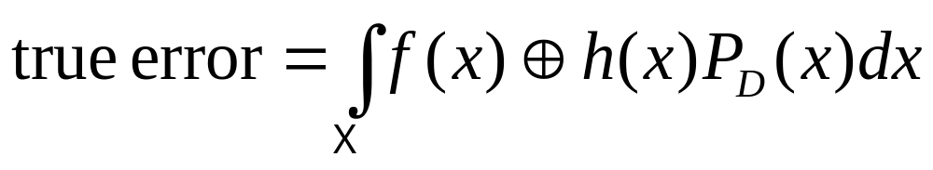
Generalisation
f(⋅)
Negative
examples
h(⋅)
Positive
examples
Connectionist Computing COMP 30230

Slide 10
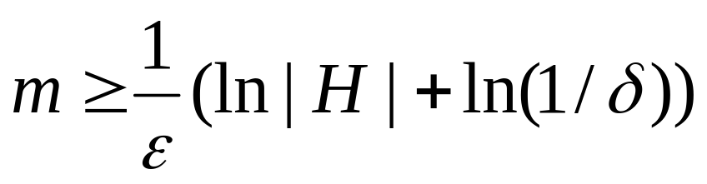
PAC learning
Probably Approximately Correct (hopefully)
H finite, unknown data distribution D, consistent learner
Then we need at least
training examples to guarantee that the true error will be < ε with probability > (1-δ)
m is called sample complexity
Connectionist Computing COMP 30230

Slide 11
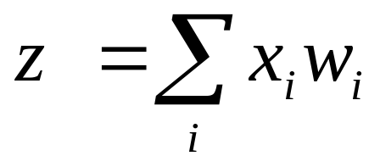
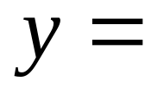
Binary threshold neuron
1
1 if z>θ
y
0 otherwise
0
z
threshold
How powerful is it, how many examples do we need? Can we apply PAC boundaries?
Connectionist Computing COMP 30230

Slide 12
Perceptron
PAC works well if we have a limited space H. But for a perceptron the hypothesis space is the set of all separation hyperplanes
How many hyperplanes in ℜ^{n}? |H|=∞ … ?
Not only, but PAC is based on consistent learners. We know that perceptrons can’t learn some tasks.
We need an extension of PAC:
VC dimension
V=Vapnik
C=Chervonenkis
Connectionist Computing COMP 30230

Slide 13
Shattering
H shatters a set of points S if for every possible dichotomy of X (way of splitting it in 2), there exists a consistent hypothesis h in H
Example: is this set of points shattered by the hypothesis space of all axis parallel rectangles?
Connectionist Computing COMP 30230

Slide 14
-
+
-
+
-
-
+
+
-
-
-
-
-
-
-
-
-
+
-
+
-
-
+
+
-
-
-
-
+
+
+
+
-
+
-
+
-
-
+
+
+
+
+
+
-
-
-
-
-
+
-
+
-
-
+
+
+
+
+
+
+
+
+
+
Connectionist Computing COMP 30230

Slide 15
VC dimension
VC(H) is the size of the largest set of points S that can be shattered by H
Examples for 2D data points:
  VC(axis-parallel-rectangles)=4
  VC(circles)=3
  VC(lines)=3
Connectionist Computing COMP 30230

Slide 16
VC dimension
For n-dimensional data points a linear decision surface has VC(H) = n+1
For instance, for a perceptron with n inputs (n-dimensional data points), VC(H)=n+1
Connectionist Computing COMP 30230

Slide 17
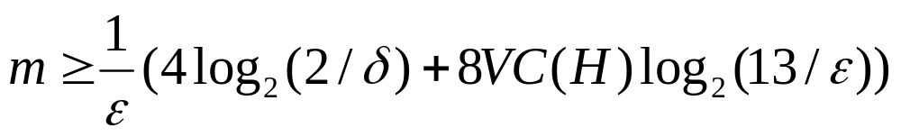
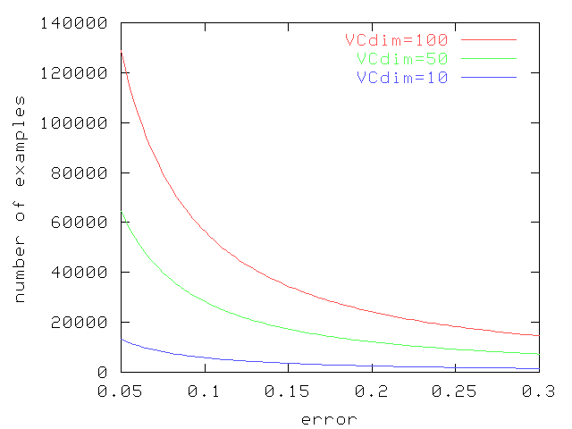
PAC learning and VC dim
δ=0.05
Connectionist Computing COMP 30230

Slide 18
PAC learning for a perceptron
n inputs -> VC(H)=n+1
Example:
100 inputs, δ=1%, ε=1%
m ≥ 100 (4 log 200 + 8 101 log 1300) = 8388.8
Connectionist Computing COMP 30230

Slide 19
Enough about learning theory for the moment.
We will get back to it soon to compute the expressive power of a new kind of network..
Connectionist Computing COMP 30230

Slide 20
Multi-layer perceptrons
So far we saw perceptrons where inputs and outputs are directly connected.
In the case of Hopfield nets/Boltzmann machines we saw that it’s possible to have hidden units, i.e. neurons that aren’t directly connected to the inputs or the outputs.
What about perceptrons with hidden units?
Connectionist Computing COMP 30230

Slide 21
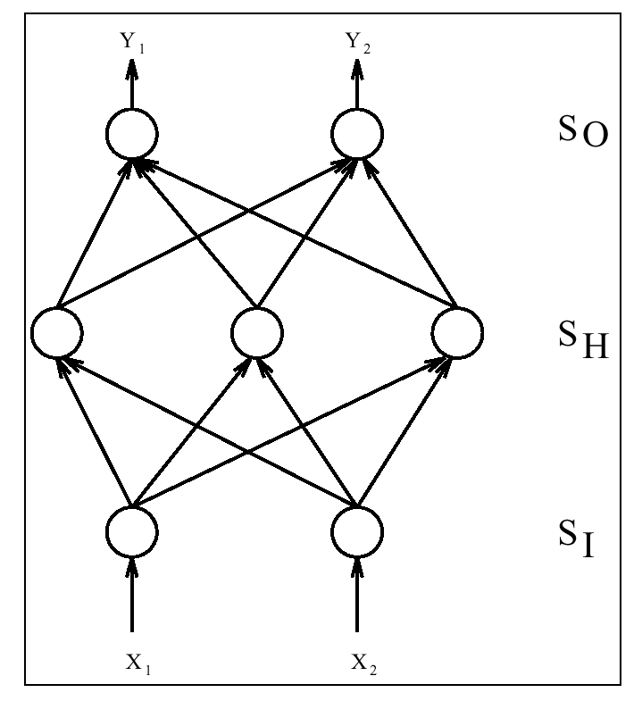
Three layer perceptron
Output layer
Hidden layer
Input layer
Connectionist Computing COMP 30230

Slide 22
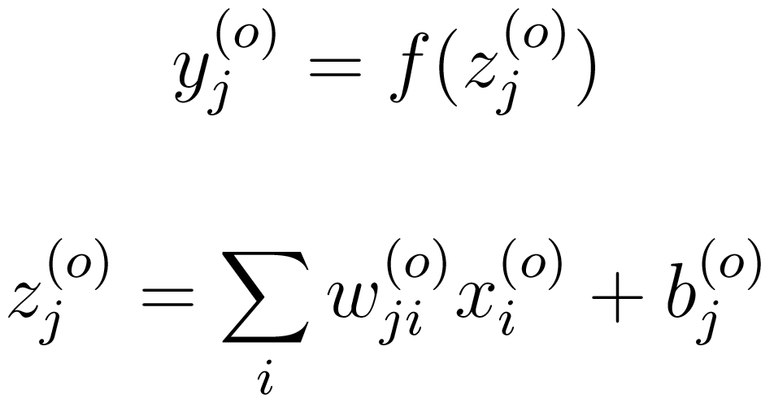
Multi-layer perceptrons
As usual, the outputs y are obtained as a linear combination of the inputs, and then passed through a squashing function (unspecified, for the moment):
y: output
z: activation
x: inputs
Connectionist Computing COMP 30230

Slide 23
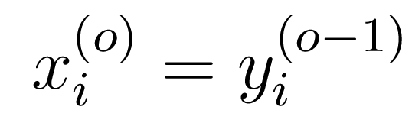
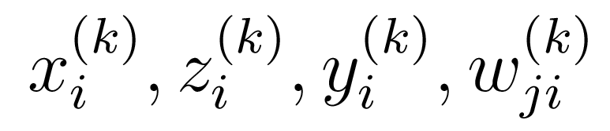
Multi-layer perceptrons
In this case though the input is the output of a lower layer of perceptrons:
We will use the superscript to denote the layer:
Connectionist Computing COMP 30230

Slide 24
Learning algorithm
Let’s assume that we have a set of examples (x1,t1), (x2,t2), .. , (xn,tn) (t for target, to distinguish from the output of the network).
As usual we want to train the model on these examples, i.e. find the weights that fit the data best.
Connectionist Computing COMP 30230

Slide 25
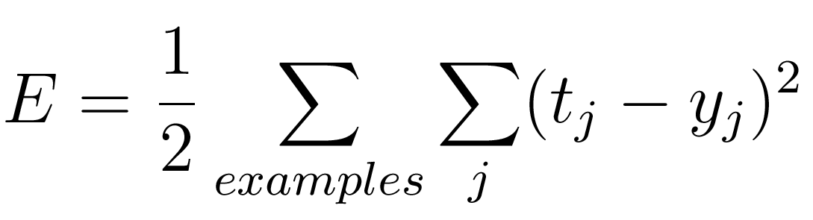
Error, or cost function
We use a squared error to define “fitting the data best”:
Connectionist Computing COMP 30230

Slide 26
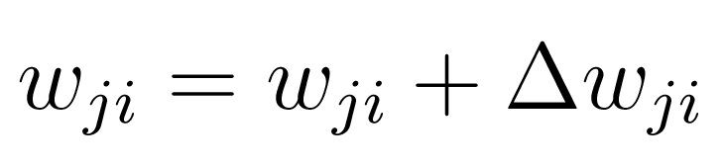
Learning algorithm
We start from some set of weights (possibly random), then we make small changes trying to minimise the cost:
Connectionist Computing COMP 30230

Slide 27
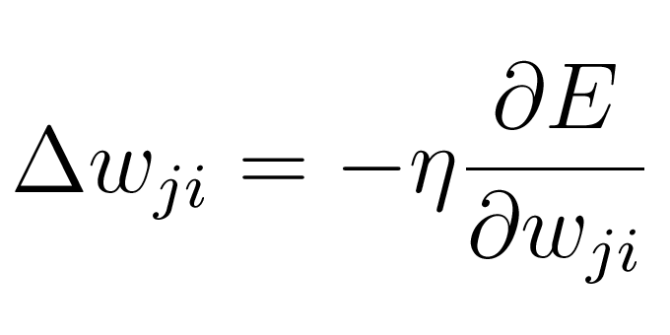
Gradient descent
To figure out how to change the weights so that the error is reduced we can do gradient descent:
This means computing the direction of steepest descent of the error and going there. We saw this already for associators.
Connectionist Computing COMP 30230

Slide 28
Multi-layer
There are multiple layers here, so the problem is a bit trickier than for associators.
The computations for the output layer of the network are really similar to those for associators though.
Connectionist Computing COMP 30230

Slide 29
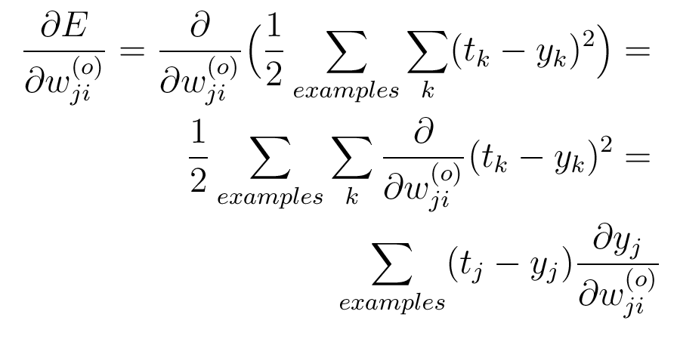
part 1
Connectionist Computing COMP 30230

Slide 30
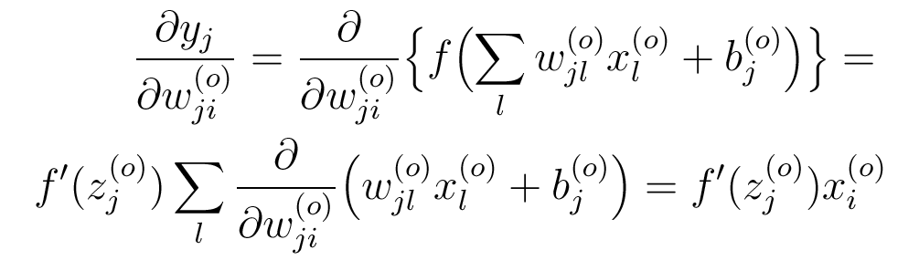
part 2
Connectionist Computing COMP 30230

Slide 31
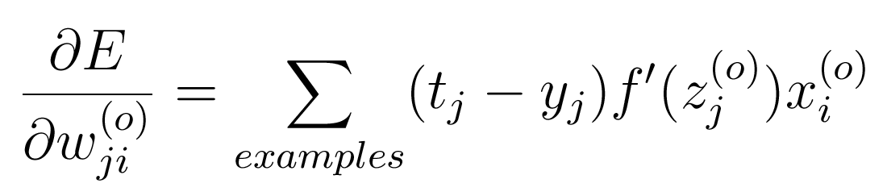
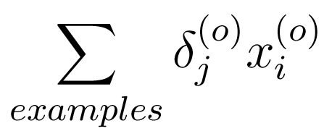
overall, for the output layer
Not too bad, in fact still fairly similar to Hebb’s law.
Which I can write as:
Connectionist Computing COMP 30230

Slide 32
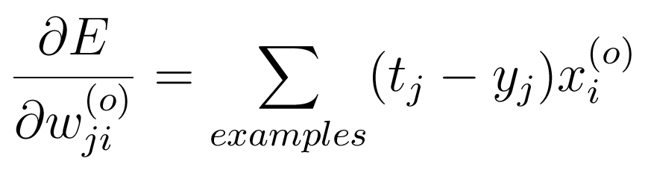
f’()
Depends on f’().
For instance, if f() is linear, f’()=1, so:
(same law as for the associator)
Connectionist Computing COMP 30230

Slide 33
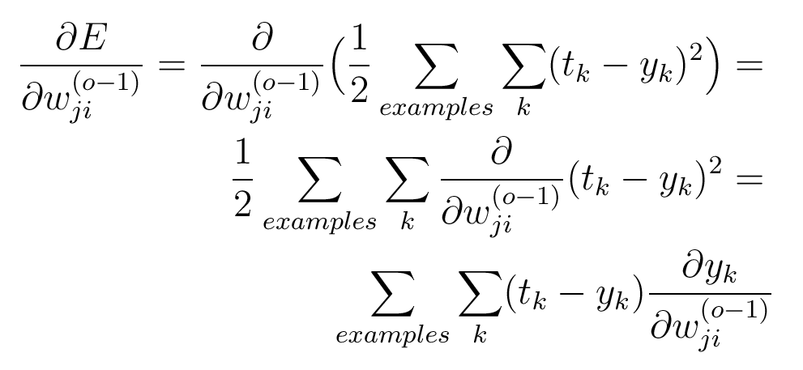
hidden layer
We can compute the derivative of the error w.r.t. the weights in the hidden layer now. The first part is this:
Connectionist Computing COMP 30230

Slide 34
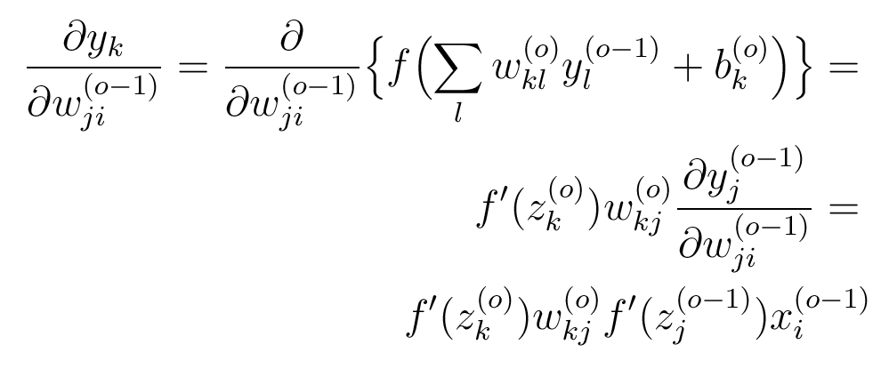
Hidden layer part 2
Connectionist Computing COMP 30230

Slide 35
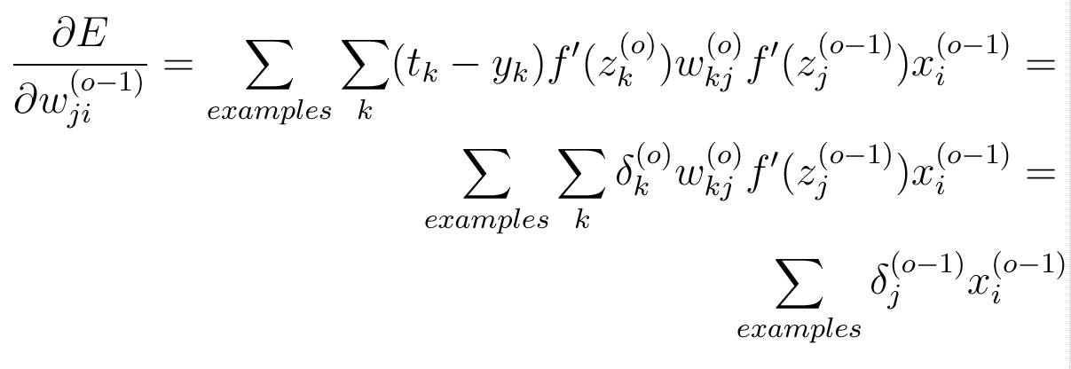
Hidden layer, overall
Connectionist Computing COMP 30230

Slide 36
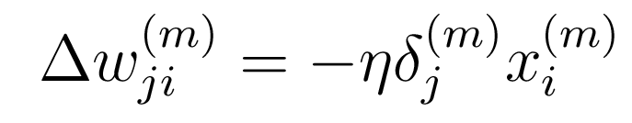
Delta rule
It turns out that this rule applies to networks with any number of layers.
For any layer the gradient of the error (and hence the appropriate weight change) can be computed as:
Connectionist Computing COMP 30230

Slide 37
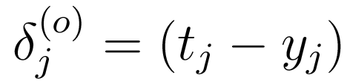
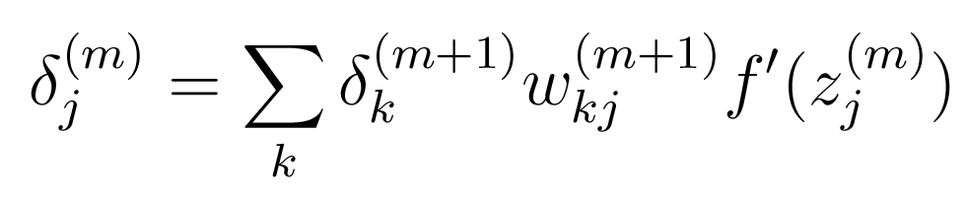
Delta rule
For the output layer, the deltas are:
For any other layer:
Connectionist Computing COMP 30230

